Slide 1
Evolution of Intel's Pentium III Processor and its Impact on Computing
Case study on
Pentium III
(Datasheet)
By
Aaryan Sharma 16010123012
Aditey Kshirsagar 16010123017
Aditya Baheti 16010123023

Slide 2
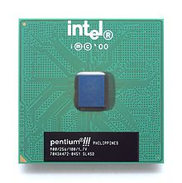
Introduction
The Intel Pentium III, released in 1999, was a significant leap in processor technology. It introduced Internet Streaming SIMD Extensions (SSE), enhancing multimedia and gaming capabilities. It also featured on-chip L2 Cache, resulting in better performance and lower power consumption compared to its predecessor, Pentium II. This processor helped Intel solidify its position in both consumer desktops and supercomputers.

Slide 3
Research Question and Motivation
Research Question How did the introduction of Pentium III’s architecture, including its innovations like SSE and on-chip cache, influence modern computing, especially in terms of performance and efficiency?
Motivation The Pentium III marked a critical turning point in computing, especially for gaming and multimedia processing. This project explores how its architectural advancements have influenced the trajectory of modern processors.

Slide 4
Objectives of the Work
Analyze the architectural changes introduced by Pentium III, especially the transition to on-chip L2 cache.
Evaluate the introduction of SSE and its impact on multimedia and gaming performance.
Assess the influence of Pentium III's power-efficient designs in modern computing.
Compare Pentium III’s innovations with those of Pentium II to show progress.

Slide 5
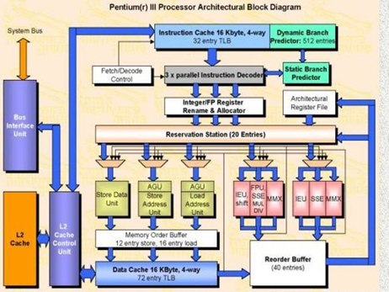
Pentium III Architecture Overview
Pentium III utilized the P6 microarchitecture.
Introduced SIMD (Single Instruction, Multiple Data) through SSE, enabling faster multimedia processing.
On-chip L2 cache (256KB), reducing memory latency and enhancing performance.
Bus Speed: 133 MHz, faster than Pentium II’s 100 MHz​(CISCCOMPARISON).

Slide 6
Comparison with Pentium II
Feature | Pentium II | Pentium III
Core Frequency | 400 MHz | 1.00 GHz
L2 Cache | 512 KB (off-chip) | 256 KB (on-chip)
Bus Speed | 100 MHz | 133 MHz
TDP | 24.3V | 29V

Slide 7
SSE and Multimedia Performance
The Streaming SIMD Extensions (SSE) introduced with Pentium III enabled faster processing of multiple data sets, improving tasks like video encoding and gaming.
This was the first Intel processor to efficiently process floating point data across multiple data points simultaneously, enabling better 3D rendering and multimedia performance​

Slide 8
Benchmark Results
Pentium III performed better in gaming and multimedia benchmarks due to faster clock speeds and on-chip cache.
L2 cache improvements allowed for smoother gameplay, especially in 3D applications​(CISCCOMPARISON).

Slide 9
Memory and Cache Improvements
Pentium III’s on-chip L2 cache allowed for faster read/write operations.
Increased write buffers (from 2 in Pentium II to 4 in Pentium III) contributed to better data flow and increased efficiency in multimedia processing​(CISCCOMPARISON).

Slide 10
Power Efficiency and Thermal Improvements
Pentium III required lower power despite its higher performance, thanks to advanced manufacturing technology (0.25 µm and later 0.13 µm).
Improved thermal management reduced damage from overheating, making the processor more reliable for continuous workloads​(CISCCOMPARISON).

Slide 11
Branch Prediction and Performance
Branch prediction in Pentium III was more accurate than in Pentium II, enhancing instruction flow and minimizing delays.
Memory streaming features and prefetching improved efficiency in multimedia tasks, ensuring smoother playback and processing​(CISCCOMPARISON).

Slide 12
Commercial Impact and Use Cases
Consumer Desktops: Widely used in gaming PCs due to its improved multimedia performance.
Supercomputers: The Xeon variant of Pentium III entered the high-performance computing sector, particularly in databases and server environments​(CISCCOMPARISON).

Slide 13
Pentium III’s Long-Term Influence
Pentium III set the stage for future processors, especially in terms of SIMD parallelism.
The innovations in on-chip caching and branch prediction have been foundational for modern processors like Intel Core​(CISCCOMPARISON).

Slide 14
Results
SIMD and SSE significantly boosted multimedia and gaming capabilities.
On-chip cache made the processor faster and more efficient in handling complex tasks.
Power-efficient designs helped pave the way for energy-conscious computing​(CISCCOMPARISON).

Slide 15
Future Work
AI and SIMD: Investigate how modern AI algorithms leverage SIMD extensions like AVX to process large datasets more efficiently.
Thermal Management: Explore how improved thermal designs could enable faster clock speeds without overheating in future processors.
Energy-Efficient Designs: Investigate new ways to balance performance with power consumption, building on the innovations of Pentium III​(CISCCOMPARISON).

Slide 16
Lessons Learned
Pentium III’s architecture proved that efficiency and performance can coexist.
SIMD parallelism is a critical element in modern high-performance computing.
Innovations in on-chip cache and branch prediction continue to influence processor designs today​(CISCCOMPARISON).

Slide 17
Conclusion
The Pentium III processor introduced key innovations in SIMD processing, on-chip caching, and power efficiency.
Its influence can still be seen in modern processors, which continue to build on its architecture to meet the demands of AI, gaming, and multimedia.
Intel’s focus on balancing performance with power efficiency set the stage for future innovations​(CISCCOMPARISON).

Slide 18
Thank You

